Slide 1
Opening a Coffee Shop in New Yory City
By: Philip Ross

Slide 2
Where to open a new business is a challenging and important question
20% of businesses fail in the first two years*
Need a location that can support the business but is not oversaturated
Safety is paramount
Coffee shops often rely on other local businesses
Partnering food and snack businesses
Acting as a neighborhood hub
Hosting Events
* From the U. S. Bureau of Labor Statistics

Slide 3
Data Acquisition and Cleansing
41 Neighborhoods taken from: New York Neighborhood Data
Location data (longitude and latitude) acquired using Geocoder
New York City police precinct data taken from: Precinct Data
Crime data could only be found as low as the precinct level
Had to be matched against borough and not neighborhoods
Crime data taken from: Crime Data
Data for the seven most dangerous crimes in New York City
Taken for 2019
Two data sets were used. One with crime data, and one without
Concern over the quality of crime data

Slide 4
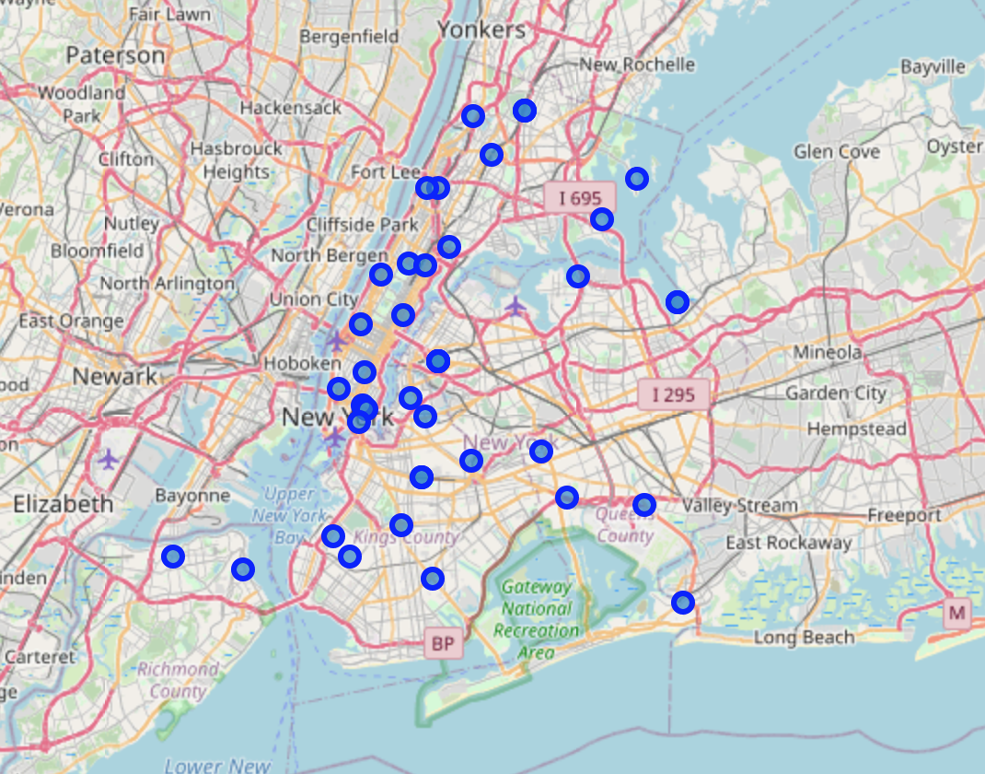
Visualization of NYC Neighborhoods

Slide 5
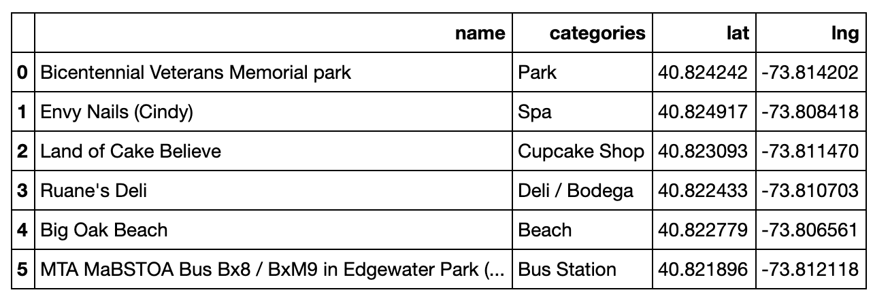
Exploration of Central Bronx
Pros:
6 venues
No coffee shops
Deli and cupcake shop to partner with
Park for people to drink coffee and host events
Cons:
Few venues
Maybe cannot support coffee shop

Slide 6
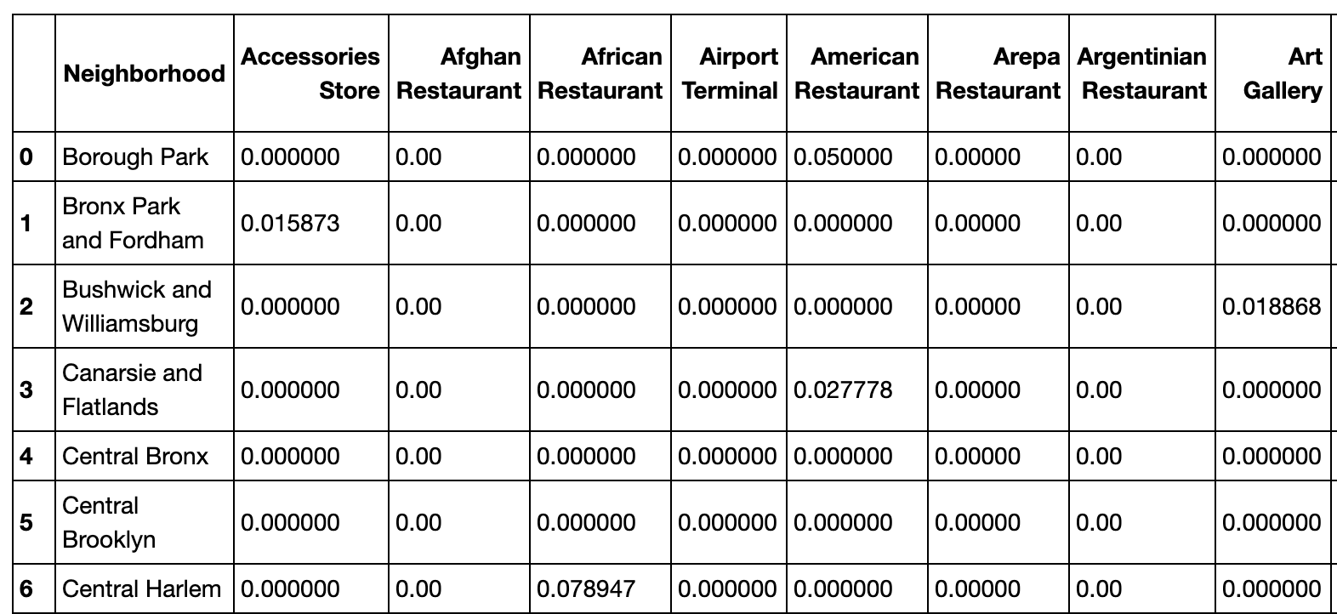
Exploring All Neighborhoods: Venue Frequency
Sample output
One-hot encoded
Frequency of venue types
Too much information

Slide 7
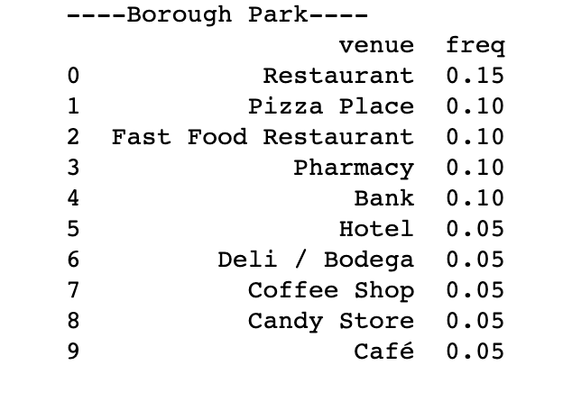
Exploring All Neighborhoods: Top 10 Most Common Venues
Easier to read
Relevant information
Not too much white noise
One for each neighborhood

Slide 8
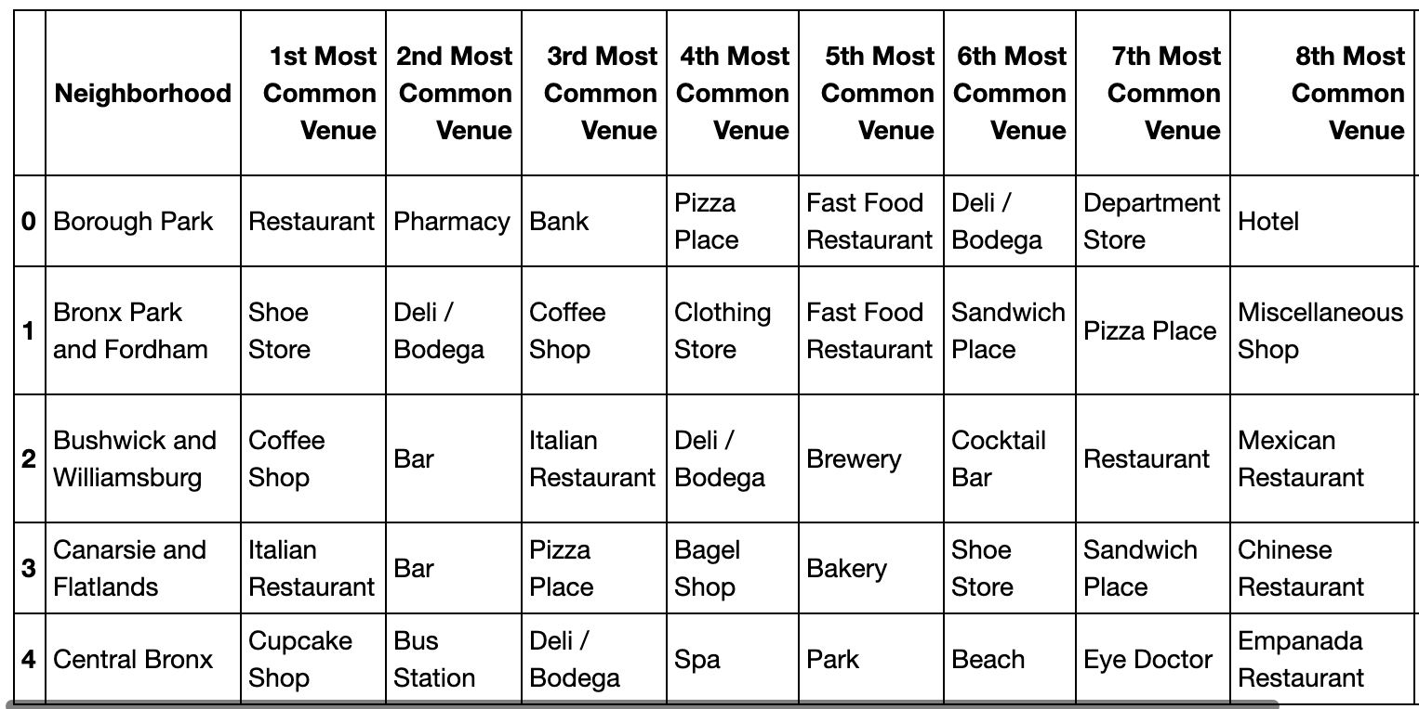
Exploring All Neighborhoods: Top 10 Most Common Venues Continued

Slide 9
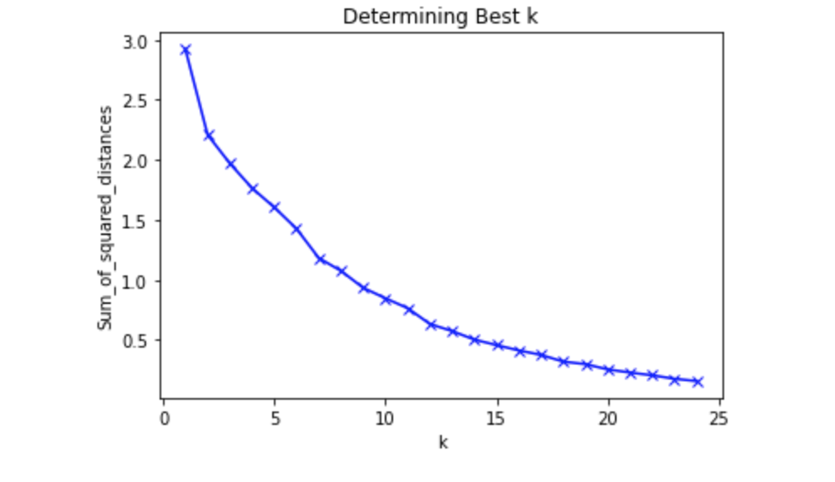
K Means Clustering without Crime Data
Sum of squared distances
From 1 to 25
Elbow method
No clear elbow determined
K = 9 used for cluster number

Slide 10
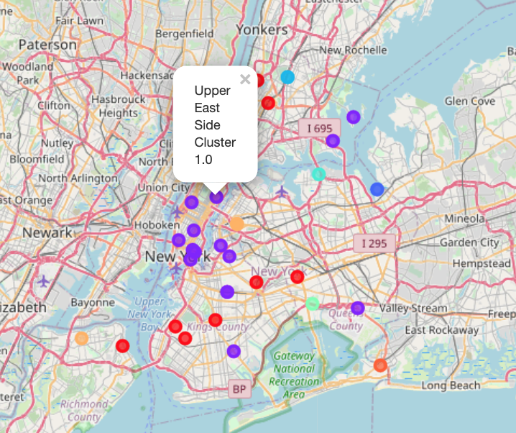
K Means Clustering w/o Crime Data: Visualization

Slide 11
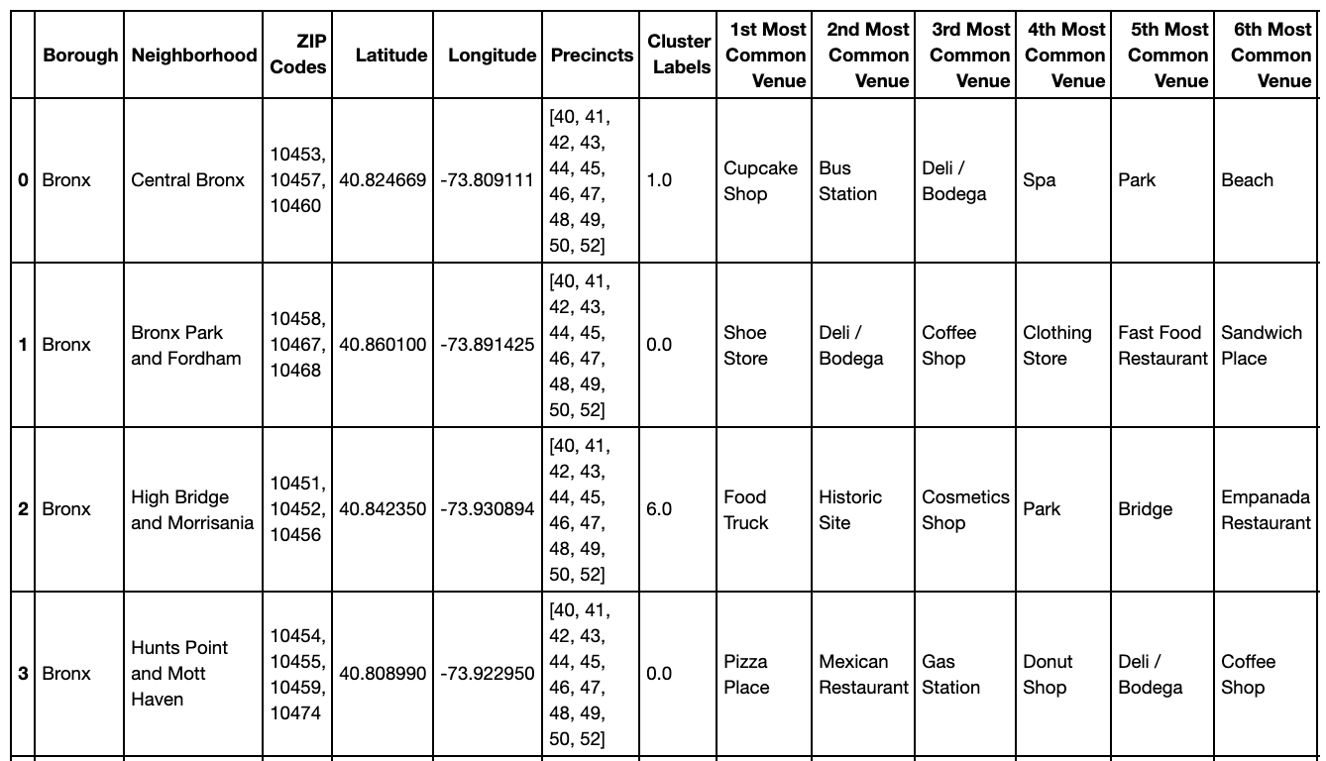
Clustering without Crime Data: Sample Cluster
Cluster 7
Mix of neighborhoods
Variety in top venues
Not limited by geographic location

Slide 12
Clustering without Crime Data: Clusters
Cluster 0: Bronx Park and Fordham, Hunts Point and Mott Haven, Kingsbridge and Riverdale, Central Brooklyn, Borough Park, Flatbush, Sunset Park, Jamaica, Stapleton and St. George
Cluster 1: Central Bronx, Southwest Brooklyn, Canarsie and Flatlands, Northwest Brooklyn, Greenpoint, Bushwick and Williamsburg, Central Harlem, Chelsea and Clinton, East Harlem, Gramercy Park and Murray Hill, Greenwich Village and Soho, Lower Manhattan, Lower East Side, Upper East Side, Upper West Side, Inwood and Washington Heights, Rockaways, Southshore, Mid-Island
Cluster 2: West Central Queens, West Queens
Cluster 3: Northeast Bronx, Southeast Bronx
Cluster 4: North Queens
Cluster 5: Southern Brooklyn
Cluster 6: High Bridge and Morrisania
Cluster 7: Northeast Queens, Northwest Queens, Southeast Queens, Southwest Queens, Port Richmond
Cluster 8: Central Queens

Slide 13
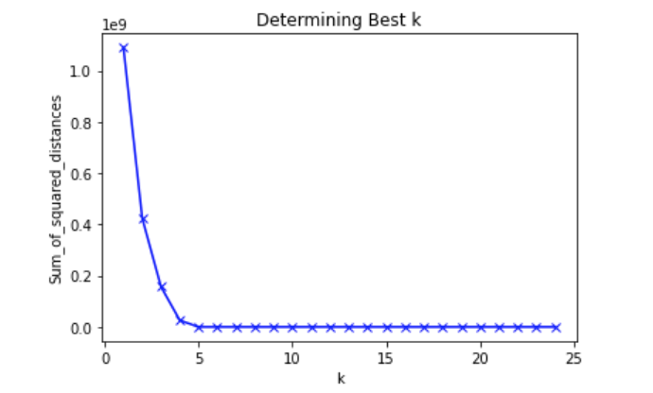
K Means Clustering with Crime Data
Sum of squared distances
From 1 to 25
Elbow method
Clear elbow determined
K = 4 used for cluster number

Slide 14
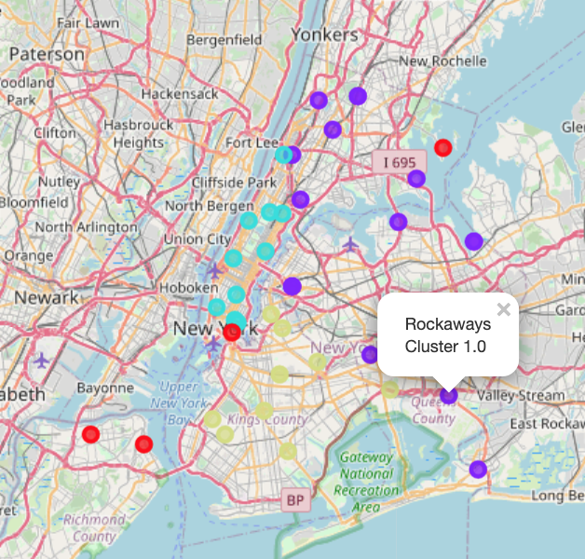
K Means Clustering with Crime Data: Visualization

Slide 15
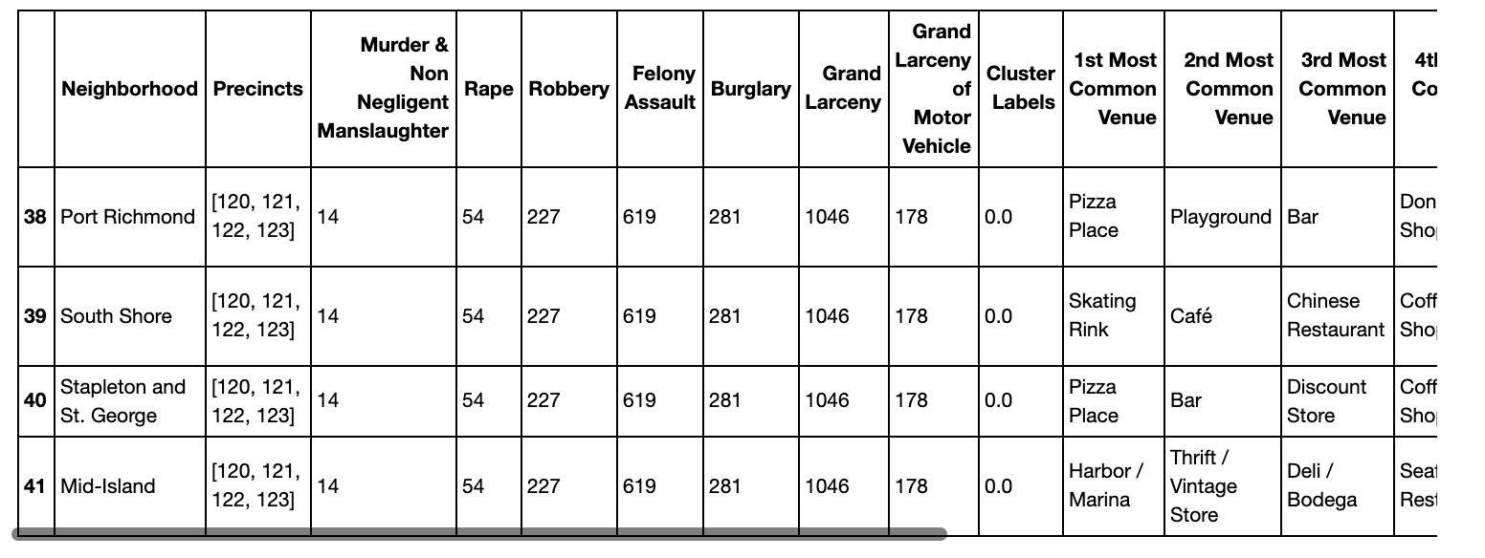
Clustering with Crime Data: Sample Cluster
Cluster 0
Consists of neighborhoods in the same precincts
Little variety geographically
Overlap between neighborhoods

Slide 16
Clustering with Crime Data: Clusters
Cluster 0: Port Richmond, South Shore, Stapleton and St. George, Mid-Island
Cluster 1: Central Bronx, Bronx Park and Fordham, High Bridge and Morrisania, Hunts Point and Mott Haven, Kingsbridge and Riverdale, Northeast Bronx, Southeast Bronx, Northeast Queens, North Queens, Central Queens, Jamaica, Northwest Queens, West Central Queens, Rockaways, Southeast Queens, Southwest Queens, West Queens
Cluster 2: Central Harlem, Chelsea and Clinton, East Harlem, Gramercy Park and Murray Hill, Greenwich Village and Soho, Lower Manhattan, Lower East Side, Upper East Side, Upper West Side, Inwood and Washington Heights
Cluster 3: Central Brooklyn, Southwest Brooklyn, Borough Park, Canarsie and Flatlands, Southern Brooklyn, Northwest Brooklyn, Flatbush, Greenpoint, Sunset Park, Bushwick and Williamsburg

Slide 17
Conclusion and Future Directions
Clustering without crime data was largely successful versus clustering with crime data
9 neighborhood clusters were achieved based on K Means
Potential neighborhoods included: Borough Park, Central Harlem, and Northeast Queens
Clustering identified other neighborhoods such as Port RIchmond
Look to include review ratings and reviews
Revisit crime data
Try to find statistics by neighborhood
Include additional years

